Slide 1
Intro to Algo Trading System
Algo Trading System
Alok Choudhary
@AlokChoudhory

Slide 2
Who am I ?
Alok Choudhary – Software Consultant
Programming Experience – 9 Years
Trading Experience - 5 Years
Developed & Delivered Enterprise Applications
Applications written in different language
Student forever
2

Slide 3
AGENDA
1) Introduction
2) Pros of Algo Trading
3) Cons of Trading System
4) Tools & Technology required
5) Basic Roadmap to Algo Trading
6) Strategies
7) Order (New & Cancel) Python Code
8) Get Nifty & Banknifty index quote
9) Links to my work
3

Slide 4
1 Introduction
Algorithmic Trading is a method of executing orders using automated pre-programmed trading instructions accounting for variables such as time, price, and volume. This type of trading was developed to make use of the speed and data processing advantages that computers have over human traders.
It is widely used by investment banks, pension funds, mutual funds, and hedge funds that may need to spread out the execution of a larger order or perform trades too fast for human traders to react to.
4

Slide 5
2 Pros of Algo Trading
Human Emotions Removed
Manual Errors Removed
Faster Execution of Orders to avoid price change
Can be Backtested on Historical & real-time data
Saving of Time
Discipline and Consistency
5

Slide 6
3 Cons of Algo Trading
Technological Dependency
Requires Programming skills
Increased Cost and Time
Over Optimization Risk
Lack of APIs and support
Regulations
System Monitoring required
6

Slide 7
4 Tools & Technology Required
It varies person to person according to his/her skills and needs.
Python, C#, Java etc
Amibroker, Spyder, PyCharm etc
Live & Historical Data Feed
Global Data Feed / True Data / Any reliable data vendor
7

Slide 8
5 Basic Roadmap to Algo Trading
1) Installation of IDE Software Spyder
2) Importing data from different data sources
3) Pandas and Matplotlib
4) Technical Analysis in python
5) TA-Lib Installation and Usage
6) Building trading models
7) Backtest, optimize & automate, performance
8) Options analysis and strategies
8

Slide 9
5.2 Importing Data From Data Sources
We can download from NSE and read from local system
Can get data from NSE by nsetools library
Can be fetched through web services
Data vendors can be used to get the data
9

Slide 10
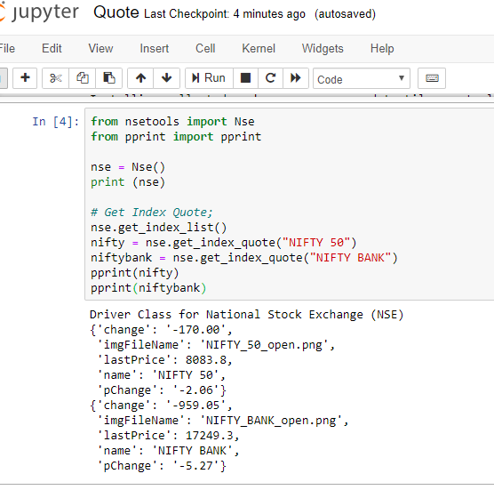
5.2 Importing Data From Data Sources Contd…
10

Slide 11
5.3 Pandas | Python Data Analysis Library
Pandas is an open source library providing high-performance, easy-to-use data structures and data analysis tools for the Python programming language. It enables to carry out entire data analysis workflow in Python without using R.
11

Slide 12
Pandas And the DataFrame
DataFrame = pythonic analog of R's data frame
Manipulating pandas DataFrames
Exploratory data analysis
Data wrangling Data preprocessing
Building models Visualization
12

Slide 13
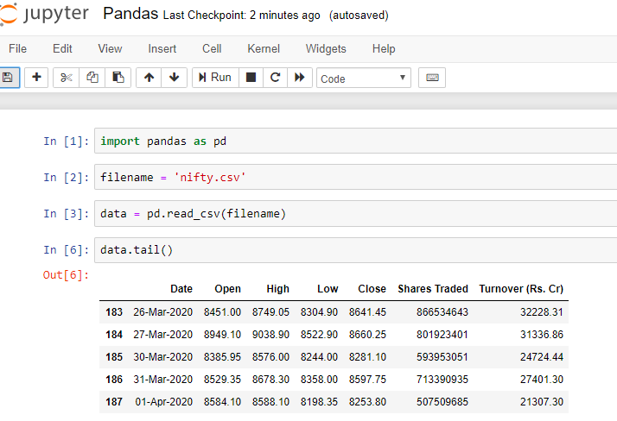
Importing using Pandas
13

Slide 14
Matplotlib
Matplotlib is a plotting library for the Python programming language and its numerical mathematics extension NumPy. It provides an object-oriented API for embedding plots into applications using general-purpose GUI toolkits like Tkinter, wxPython, Qt, or GTK+
en.wikipedia.org/wiki/Matplotlib
14

Slide 15
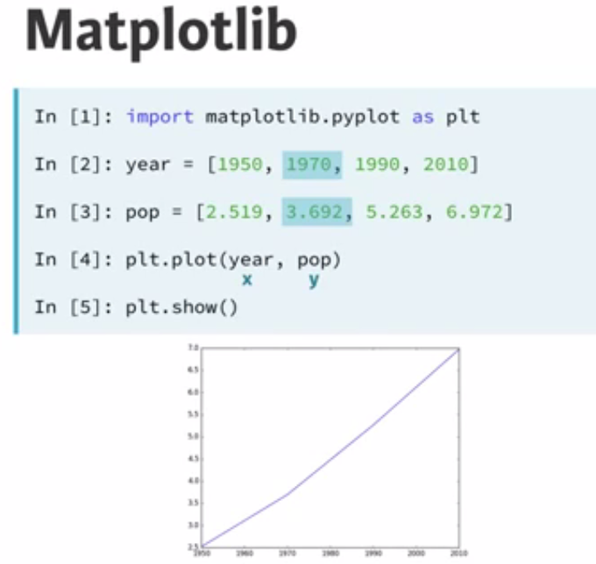
Matplotlib
15

Slide 16
5.4 Technical Analysis in Python
Technical analysis packages are used for performing numerical and statistical operations, reading or downloading data, charting data and performing stock technical analysis operations
Below python packages to install
numpy || pip install numpy
pandas || pip install pandas
matplotlib || pip install matplotlib
nsetools || pip install nsetools
TA-Lib Steps in next slide..
16

Slide 17
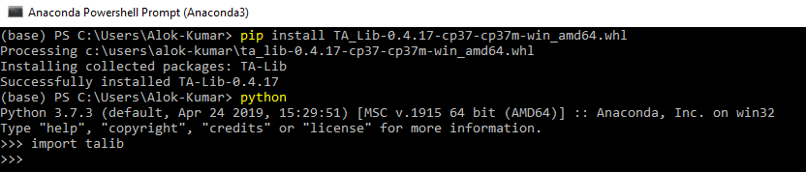
5.5 TA-Lib Installation and Usage
Steps to install TALib on Windows
Step 1: Download TA_Lib‑0.4.17‑cp37‑cp37m‑win_amd64.whl from
https://www.lfd.uci.edu/~gohlke/pythonlibs/#ta-lib
Step2: Open Anaconda Power Shell Prompt and type below command
pip install TA_Lib-0.4.17-cp37-cp37m-win_amd64.whl
17

Slide 18
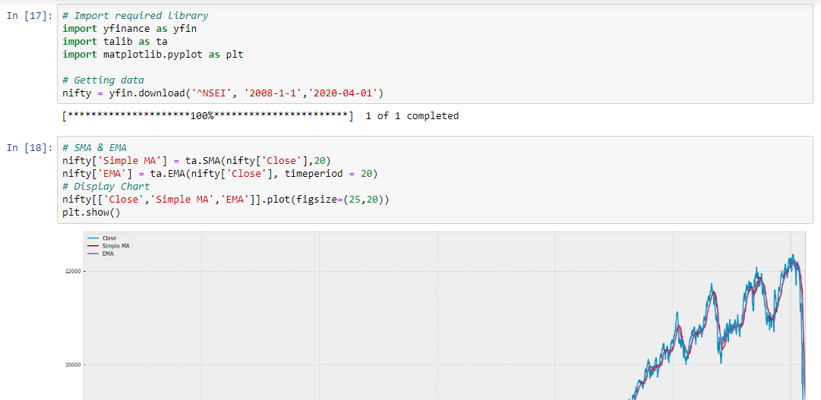
TA-Lib Installation and Usage Contd…
18

Slide 19
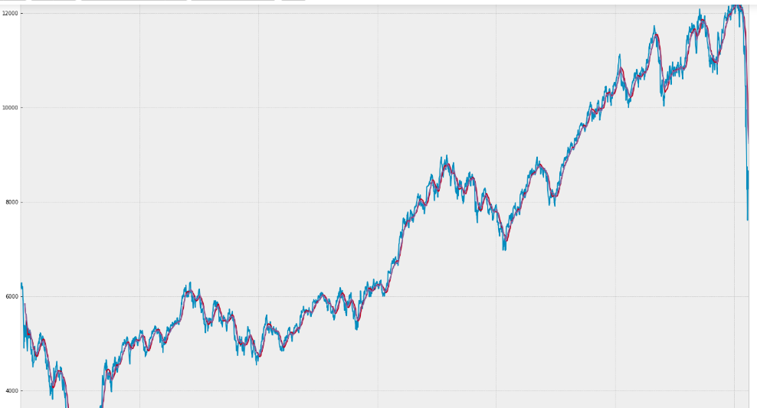
TA-Lib Installation and Usage Contd…
19

Slide 20
Technical Analysis in Python
Types of Technical Analysis
Volume Indicators
Volatility Indicators
Trend Indicators
Momentum Indicators
Others Indicators
https://github.com/alokchoudhary01/ta
https://en.wikipedia.org/wiki/Technical_analysis
20

Slide 21
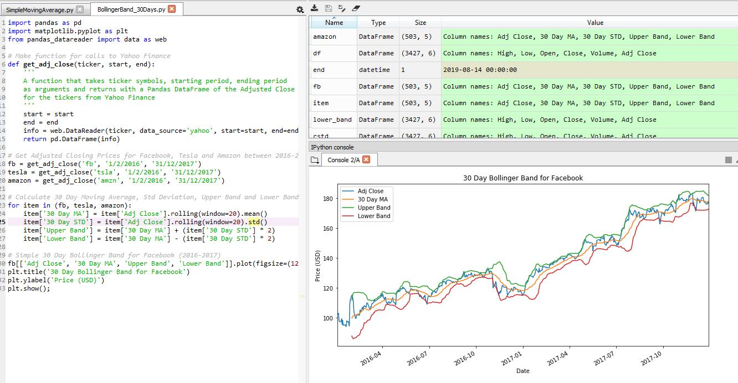
Volatality Indicators
Bollinger Bands (BB) 30 day Facebook Python Code
21

Slide 22
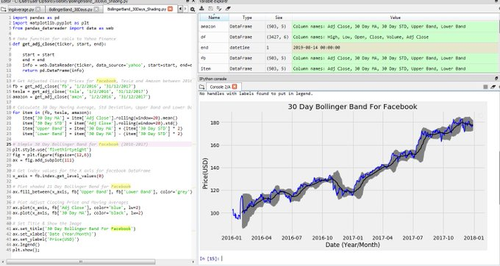
Volatality Indicators
Shading the critical areas between the upper and lower bands. Matplotlib can handle plot shading as well.
22

Slide 23
5.6 Building Trading Algorithms with Python
Time for Coding and Debugging
Design and Development:
Implementing stock market analysis
Designing a trading algorithm for selling and buying Structuring a trading bot
Run trial trades
Implementing Stock Market Analysis in Python includes
Financial analysis on stock market data
Learning about returns and moving averages
Coding the strategy
23

Slide 24
Design Backtest Optimize Automate Performance
Preliminary Research:
Develop a strategy that suits personal needs
Example - risk profile, time commitment, trading capital
Identify persistent marketing efficiency
24

Slide 25
5.7 Backtesting
Focus on validating the trading bot
Check code
Understand performance over different time frame and asset classes
Optimization:
Maximize performance by minimizing the overfitting price
Select good performance measures
Avoid overfitting bias
25

Slide 26
Live Execution
Select the appropriate broker
Implement mechanism to manage market and operation risk
Verify the bot's performance
Continuous monitoring
26

Slide 27
6 Strategies
Pairs trading
Delta-neutral strategies
Arbitrage
Mean reversion
Scalping
27

Slide 28
Get Nifty & Banknifty Index Quote
28

Slide 29
from upstox_api.api import *
s = Session ('QDJlD2Dmya512lyyUcety8aYlSUDZtJA9Bx66pvk')
s.set_redirect_uri ("http://localhost:7001/TWeb/Login")
s.set_api_secret ('w91y81at37')
s.set_code ('4b4324a3cc41aaa308710029b93a01e0dc6b6cf4')
access_token = s.retrieve_access_token()
#print ('Received access_token: %s' % access_token)
u = Upstox ('QDJlD2Dmya512lyyUcety8aYlSUDZtJA9Bx66pvk', access_token)
print("Instance Initialized...")
#print (u.get_profile())
#u.get_master_contract('nse_eq')
print("Calling New Order")
print(u.get_master_contract('NSE_FO'))
u.place_order(TransactionType.Buy,u.get_instrument_by_symbol('NSE_FO', 'NIFTY 50'),1,OrderType.Limit,ProductType.Intraday,10000.0,None,0,DurationType.DAY,None,None,None )
#u.cancel_all_orders() #Cancel all open orders
print("Order placed")
print("Order Status: Success: Your order has been placed and forward to exchange..")

Slide 30
9 Links to my work
Algorithmic Trading?
https://twitter.com/AlokChoudhory/status/1172324686111232001?s=20
What is an Algorithm?
https://twitter.com/AlokChoudhory/status/1172322186926817280?s=20
Anaconda Navigator is good tool for Data Science work
https://twitter.com/AlokChoudhory/status/1160431175116050432?s=20
Python coding to see OHLC:
https://twitter.com/AlokChoudhory/status/1168551079283322882?s=20
Read Nifty/Banknifty csv in Python | Kaggle:
https://twitter.com/AlokChoudhory/status/1164162435445452800?s=20
How to read Nifty data and plot basic chart
https://twitter.com/AlokChoudhory/status/1161902922331906050?s=20
How to get Banknifty Index quote in python
https://twitter.com/AlokChoudhory/status/1161581964517752833?s=20
30

Slide 31
9 Links to my work contd…
Yes Bank Order Placed:
https://twitter.com/AlokChoudhory/status/1177590128484601858?s=20
Backtesting Hello World:
https://twitter.com/AlokChoudhory/status/1164951263726804992?s=20
Backtesting in Jupyter's VPython | Apple Data:
https://twitter.com/AlokChoudhory/status/1163494296806289408?s=20
How to install and setup Amibroker Database:
https://twitter.com/AlokChoudhory/status/1170587995981746176?s=20
Technical Analysis using Amibroker:
https://twitter.com/AlokChoudhory/status/1170653642279407621?s=20
Encryption Logic VB.NET codding for 5Paisa API:
https://twitter.com/AlokChoudhory/status/1169551029920092162?s=20
31

Slide 32
Thank You
Twitter: @AlokChoudhory
Email: alokser@gmail.com
32

